Slide 1
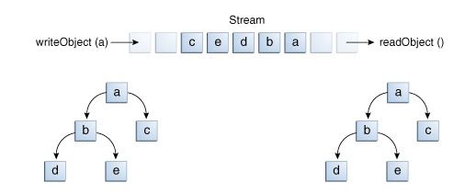
Serialization - Output and Input of Complex Objects
writeObject is invoked to write a single object named a. This object contains references to objects b and c, while b contains references to d and e. Invoking writeobject(a) writes not just a, but all the objects necessary to reconstitute a, so the other four objects in this web are written also.
When a is read back by readObject, the other four objects are read back as well, and all the original object references are preserved.

